Slide 1
Chapter 10
Basic Regression Analysis with Time Series Data
<number>
Notes:
<number>

Slide 2
Basic Regression Analysis with Time Series Data (1 of 25)
The nature of time series data
Temporal ordering of observations; may not be arbitrarily reordered
Typical features: serial correlation/nonindependence of observations
How should we think about the randomness in time series data?
The outcome of economic variables (e.g. GNP, Dow Jones) is uncertain; they should therefore be modeled as random variables.
Time series are sequences of r.v. (= stochastic processes)
Randomness does not come from sampling from a population.
“Sample” = the one realized path of the time series out of the many possible paths the stochastic process could have taken.
<number>

Slide 3
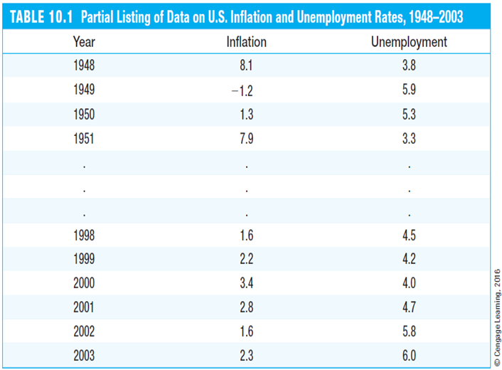
Basic Regression Analysis with Time Series Data (2 of 25)
Example: US inflation and unemployment rates 1948-2003
Year | Inflation | Unemployment
1948 | 8.1 | 3.8
1949 | -1.2 | 5.9
1950 | 1.3 | 5.3
1951 | 7.9 | 3.3
… | … | …
1998 | 1.6 | 4.5
1999 | 2.2 | 4.2
2000 | 3.4 | 4.0
2001 | 2.8 | 4.7
2002 | 1.6 | 5.8
2003 | 2.3 | 6.0
Here, there are only two time series. There may be many more variables whose paths over time are observed simultaneously.
Time series analysis focuses on modeling the dependency of a variable on its own past, and on the present and past values of other variables.
<number>

Slide 4
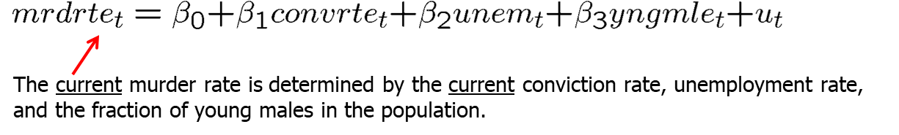
Basic Regression Analysis with Time Series Data (3 of 25)
Examples of time series regression models
Static models
In static time series models, the current value of one variable is modeled as the result of the current values of explanatory variables
Examples for static models
<number>

Slide 5
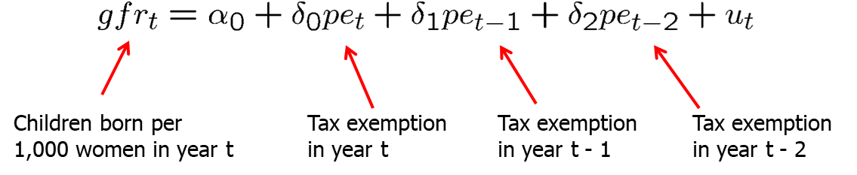
Basic Regression Analysis with Time Series Data (4 of 25)
Finite distributed lag models
In finite distributed lag models, the explanatory variables are allowed to influence the dependent variable with a time lag.
Example for a finite distributed lag model
The fertility rate may depend on the tax value of a child, but for biological and behavioral reasons, the effect may have a lag.j
<number>

Slide 6
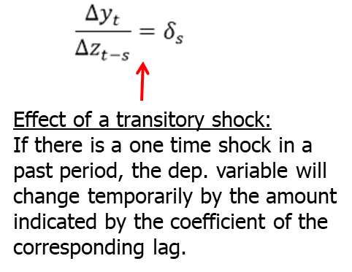
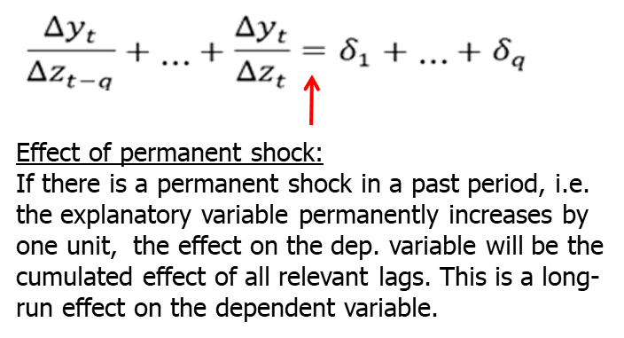
Basic Regression Analysis with Time Series Data (5 of 25)
Interpretation of the effects in finite distributed lag models
Effect of a past shock on the current value of the dep. variable
<number>
Notes:
<number>

Slide 7
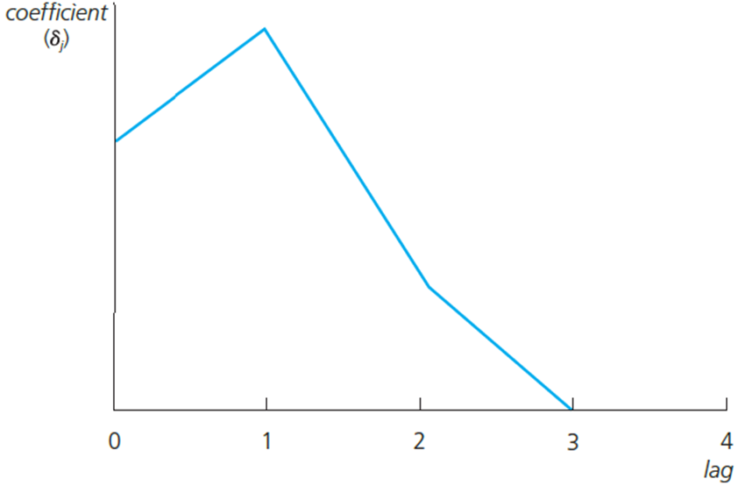
Basic Regression Analysis with Time Series Data (6 of 25)
Graphical illustration of lagged effects
The effect is biggest after a lag of one period. After that, the effect vanishes (if the initial shock was transitory).
The long run effect of a permanent shock is the cumulated effect of all relevant lagged effects. It does not vanish (if the initial shock is a permanent one).
<number>

Slide 8
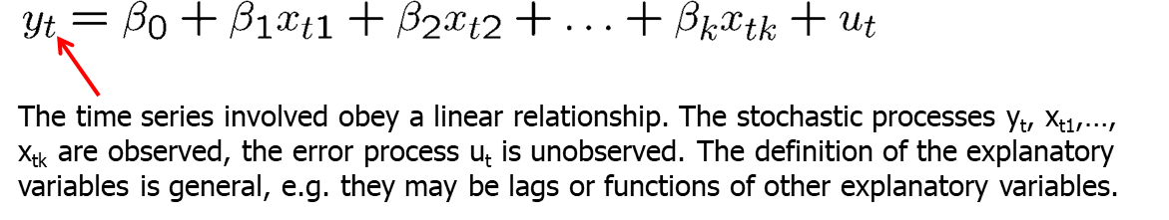
Basic Regression Analysis with Time Series Data (7 of 25)
Finite sample properties of OLS under classical assumptions
Assumption TS.1 (Linear in parameters)
Assumption TS.2 (No perfect collinearity)
“In the sample (and therefore in the underlying time series process), no independent variable is constant nor a perfect linear combination of the others.”
<number>

Slide 9
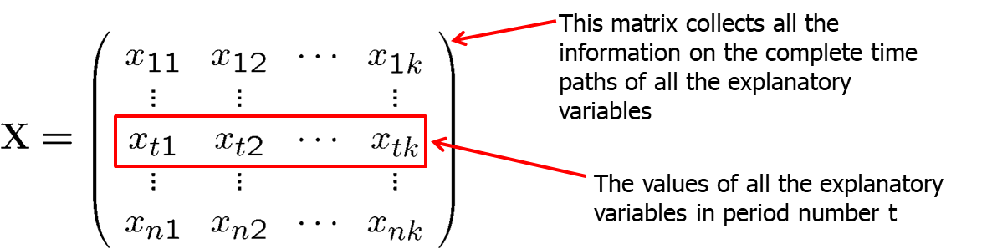
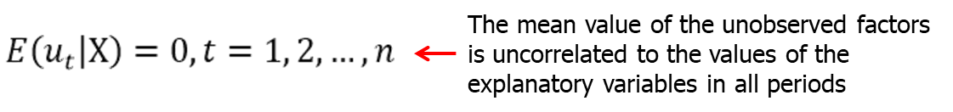
Basic Regression Analysis with Time Series Data (8 of 25)
Notation
Assumption TS.3 (Zero conditional mean)
<number>

Slide 10
Basic Regression Analysis with Time Series Data (9 of 25)
Discussion of assumption TS.3
Strict exogeneity is stronger than contemporaneous exogeneity
TS.3 rules out feedback from the dependent variable on future values of the explanatory variables; this is often questionable especially if explanatory variables “adjust” to past changes in the dependent variable.
If the error term is related to past values of the explanatory variables, one should include these values as contemporaneous regressors.
<number>

Slide 11
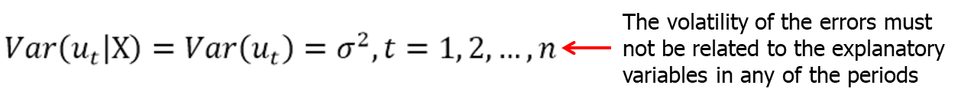
Basic Regression Analysis with Time Series Data (10 of 25)
Theorem 10.1 (Unbiasedness of OLS)
Assumption TS.4 (Homoskedasticity)
A sufficient condition is that the volatility of the error is independent of the explanatory variables and that it is constant over time.
In the time series context, homoskedasticity may also be easily violated, e.g. if the volatility of the dep. variable depends on regime changes.
<number>

Slide 12
Basic Regression Analysis with Time Series Data (11 of 25)
Assumption TS.5 (No serial correlation)
Discussion of assumption TS.5
Why was such an assumption not made in the cross-sectional case?
The assumption may easily be violated if, conditional on knowing the values of the indep. variables, omitted factors are correlated over time.
The assumption may also serve as substitute for the random sampling assumption if sampling a cross-section is not done completely randomly.
In this case, given the values of the explanatory variables, errors have to be uncorrelated across cross-sectional units (e.g. states).
<number>

Slide 13
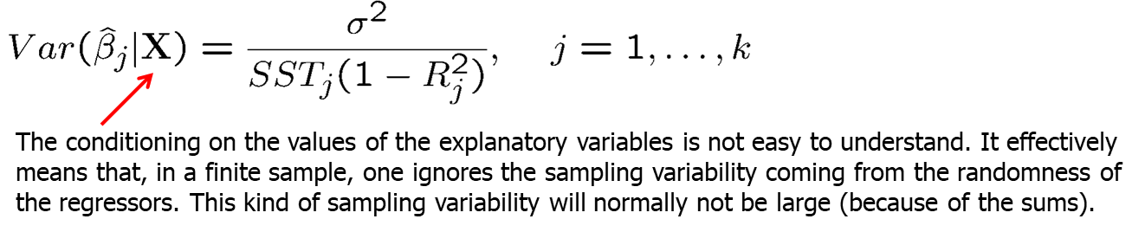
Basic Regression Analysis with Time Series Data (12 of 25)
Theorem 10.2 (OLS sampling variances)
Under assumptions TS.1 – TS.5:
Theorem 10.3 (Unbiased estimation of the error variance)
<number>

Slide 14
Basic Regression Analysis with Time Series Data (13 of 25)
Theorem 10.4 (Gauss-Markov Theorem)
Under assumptions TS.1 – TS.5, the OLS estimators have the minimal variance of all linear unbiased estimators of the regression coefficients.
This holds conditional as well as unconditional on the regressors.
Assumption TS.6 (Normality)
Theorem 10.5 (Normal sampling distributions)
Under assumptions TS.1 – TS.6, the OLS estimators have the usual normal distribution (conditional on X). The usual F and t-tests are valid.
<number>

Slide 15
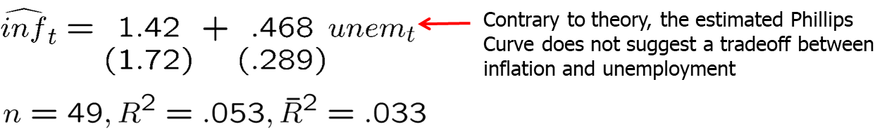
Basic Regression Analysis with Time Series Data (14 of 25)
Example: Static Phillips curve
Discussion of CLM assumptions
TS.1: The error term contains factors such as monetary shocks, income/demand shocks, oil price shocks, supply shocks, or exchange rate shocks.
TS.2: A linear relationship might be restrictive, but it should be a good approximation. Perfect collinearity is not a problem as long as unemployment varies over time.
<number>

Slide 16

Basic Regression Analysis with Time Series Data (15 of 25)
Discussion of CLM assumptions (cont.)
<number>

Slide 17
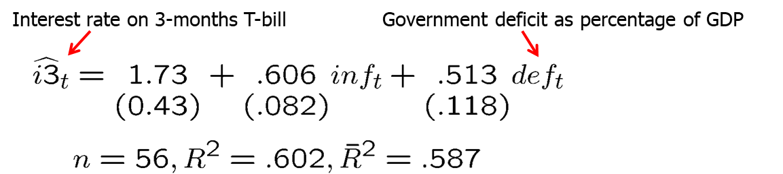
Basic Regression Analysis with Time Series Data (16 of 25)
Example: Effects of inflation and deficits on interest rates
Discussion of CLM assumptions
TS.1: The error term represents other factors that determine interest rates in general, e.g. business cycle effects.
TS.2: A linear relationship might be restrictive, but it should be a good approximation. Perfect collinearity will seldomly be a problem in practice.
<number>

Slide 18
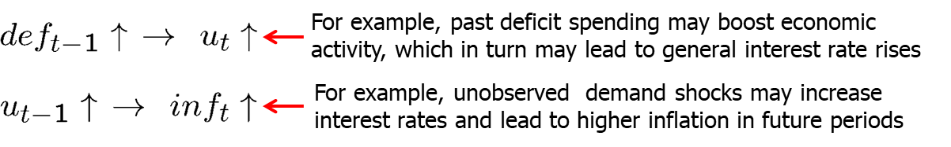

Basic Regression Analysis with Time Series Data (17 of 25)
Discussion of CLM assumptions (cont.)
<number>

Slide 19
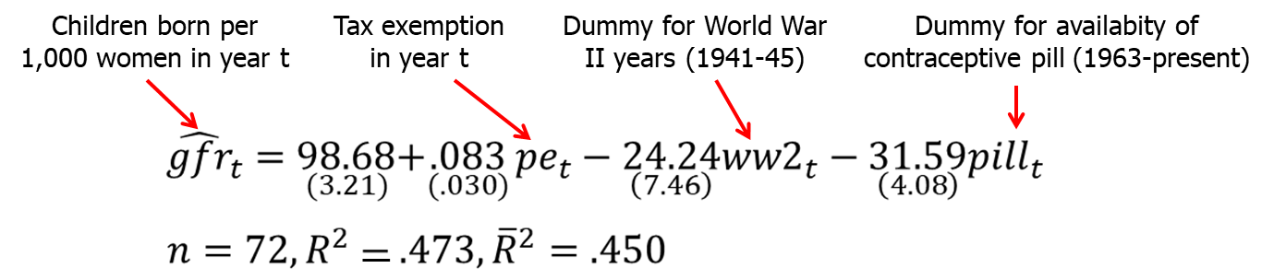
Basic Regression Analysis with Time Series Data (18 of 25)
Using dummy explanatory variables in time series
Interpretation
During World War II, the fertility rate was temporarily lower.
It has been permanently lower since the introduction of the pill in 1963.
<number>

Slide 20
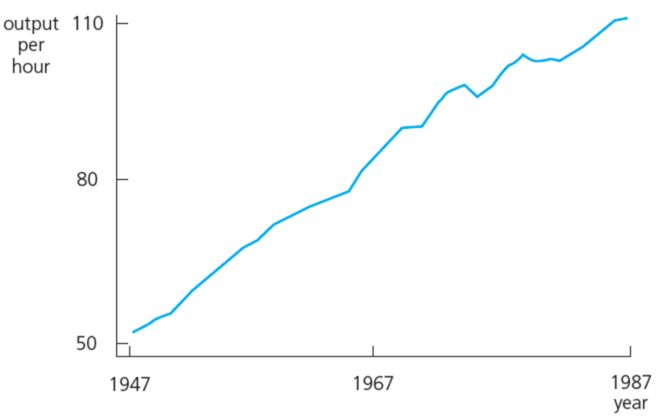
Basic Regression Analysis with Time Series Data (19 of 25)
Time series with trends
Example for a time series with a linear upward trend:
<number>

Slide 21
Basic Regression Analysis with Time Series Data (20 of 25)
Modelling a linear time trend
Modelling an exponential time trend
<number>

Slide 22
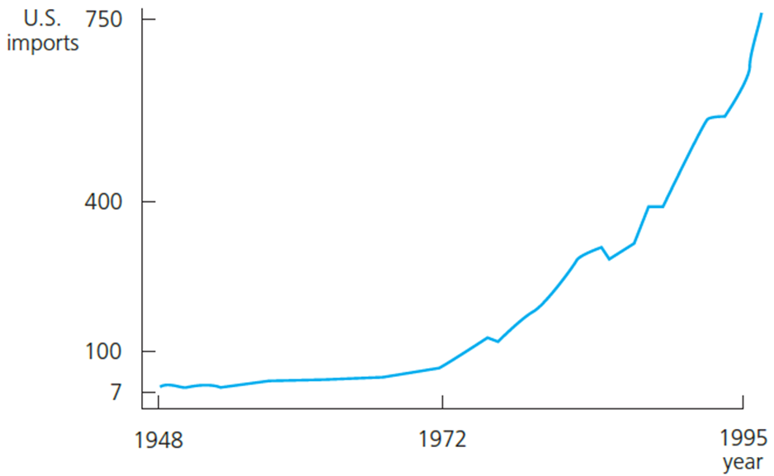
Basic Regression Analysis with Time Series Data (21 of 25)
Example for a time series with an exponential trend
Abstracting from random deviations, the time series has a constant growth rate
<number>

Slide 23
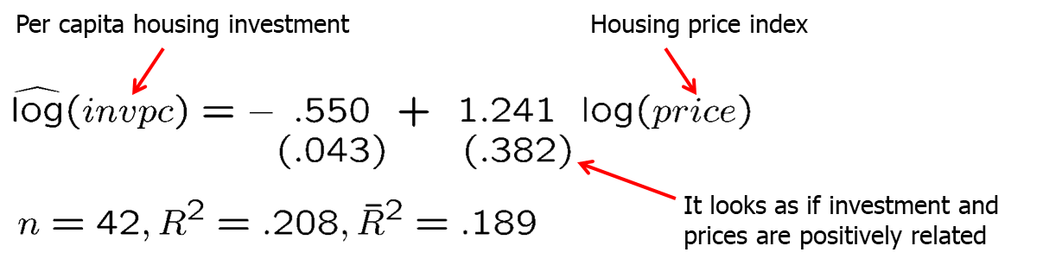
Basic Regression Analysis with Time Series Data (22 of 25)
Using trending variables in regression analysis
If trending variables are regressed on each other, a spurious relationship may arise if the variables are driven by a common trend.
In this case, it is important to include a trend in the regression.
Example: Housing investment and prices
<number>

Slide 24
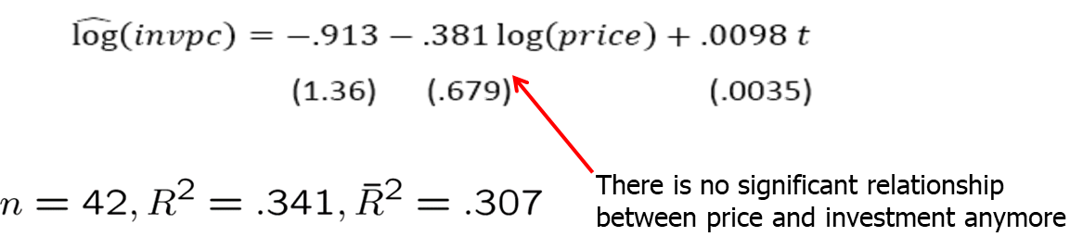
Basic Regression Analysis with Time Series Data (23 of 25)
Example: Housing investment and prices (cont.)
When should a trend be included?
If the dependent variable displays an obvious trending behaviour
If both the dependent and some independent variables have trends
If only some of the independent variables have trends; their effect on the dependent variable may only be visible after a trend has been substracted
<number>

Slide 25
Basic Regression Analysis with Time Series Data (24 of 25)
A detrending interpretation of regressions with a time trend
It turns out that the OLS coefficients in a regression including a trend are the same as the coefficients in a regression without a trend but where all the variables have been detrended before the regression.
This follows from the general interpretation of multiple regressions.
Computing R-squared when the dependent variable is trending
Due to the trend, the variance of the dependent variable will be overstated.
It is better to first detrend the dependent variable and then run the regression on all the independent variables (plus a trend if they are trending as well).
The R-squared of this regression is a more adequate measure of fit.
<number>

Slide 26
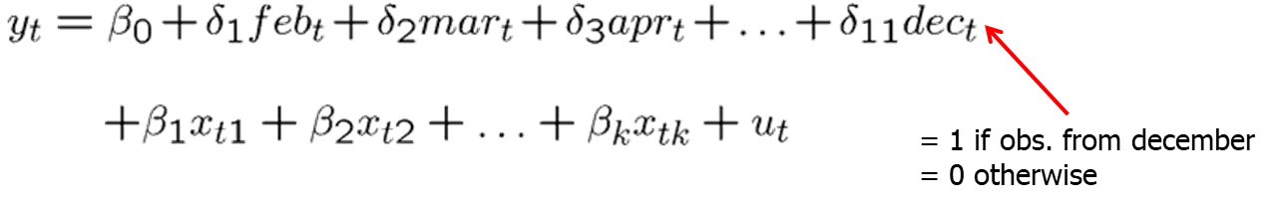
Basic Regression Analysis with Time Series Data (25 of 25)
Modelling seasonality in time series
A simple method is to include a set of seasonal dummies:
Similar remarks apply as in the case of deterministic time trends
The regression coefficients on the explanatory variables can be seen as the result of first deseasonalizing the dep. and the explanatory variables.
An R-squared that is based on first deseasonalizing the dependent variable may better reflect the explanatory power of the explanatory variables.
<number>

